Slide 1
IDMP Project
Netflix Show Analysis
PRESENTED BY
Nikhil Gudipally
Prajakta Ghumatkar
Sindhya Balasubramanian
Vishnu Rohan Surapaneni

Slide 2


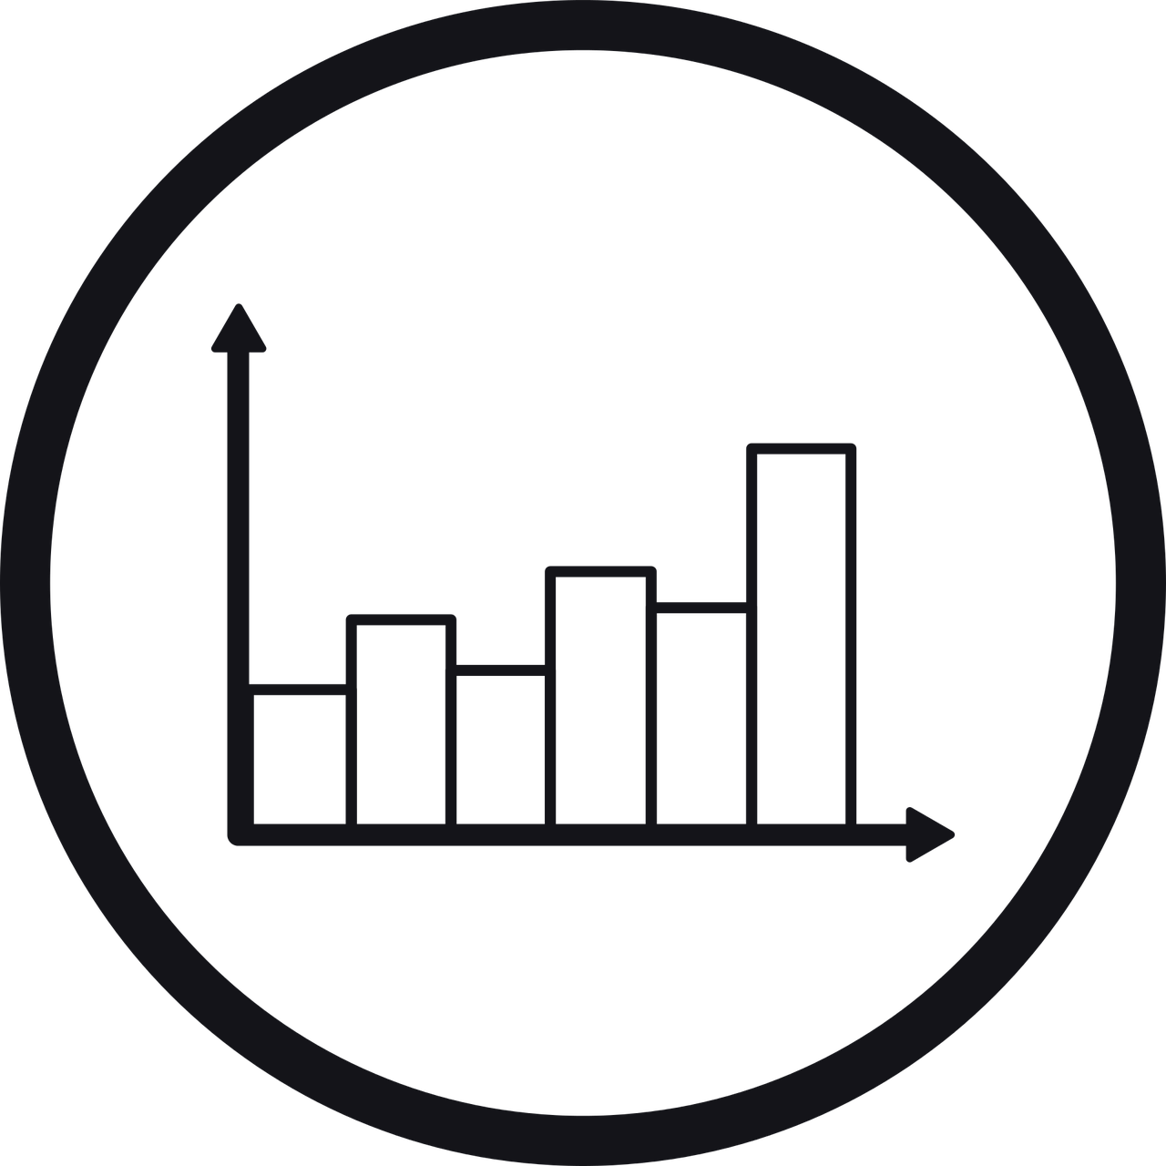

AGENDA
SUMMARY
METHODS
RESULTS
NEXT
STEPS

Slide 3
Summary
Field Name | Description
Title | Name of the movie/series
Genre | Genre of the show
Actors | Names of all actors
Directors | Name of director
Languages | Show availability in different languages
Series.or.Movie | Indicates whether its a movie or a series
Hidden.Gem.Score | Scores provided for movies/shows that have very high rating but very little viewership
Country.Availability | Countries that the shows are actually available in.
Runtime | Duration of the show
score | Combined score from IMDB rating and Rotten Tomatoes Rating
Project background : The viewership has moved from traditional media such as Television to more non-standard media such as Over the Top media (OTT media)
Goal : To understand customer preferences based on their Netflix viewership behavior and build a recommendation system to increase viewership
Dataset : contains information on close to 15.5K Netflix shows and movies alongside 26 descriptive attributes (Refer Table on Slide)
Methods and results : Performed PCA and t-SNE for dimensionality reduction and further used hierarchical and K-means clustering techniques to cluster the data.

Slide 4
AGENDA
SUMMARY
METHODS
RESULTS
NEXT
STEPS

Slide 5


METHODS
Data Tidying
Visualization
Data: Population
Attributes Added:
Score - IMDB Score and Rotten Tomatoes Scores were combined
Attributes Modified:
Genre, Languages, Country, Director, Actors - Column separated by comma into new rows
Attributes Removed:
All Rating attributes except Score variable created
Metadata such as youtube link, Netflix link, image etc
Data: Population
Key Attributes:
Score
Language
Genre
Series or Movies
Director
Writer
Duration
Refer to Appendix A for Visualizations

Slide 6
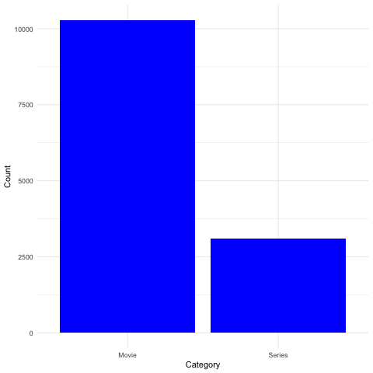
DISTRIBUTION OF SHOWS AND MOVIES

Slide 7
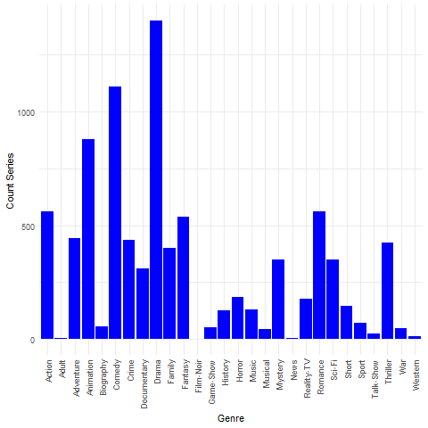
DISTRIBUTION OF GENRES OVER SHOWS

Slide 8
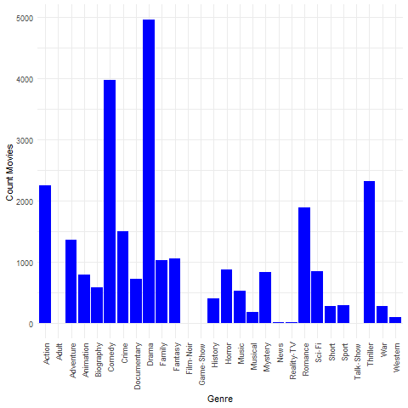
DISTRIBUTION OF GENRES OVER MOVIES

Slide 9
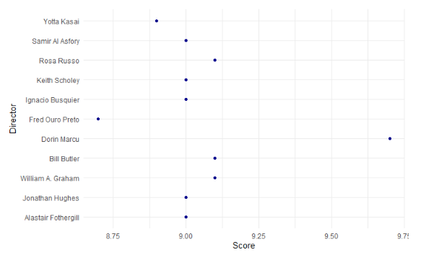
DIRECTOR RATINGS OVER MOVIES

Slide 10
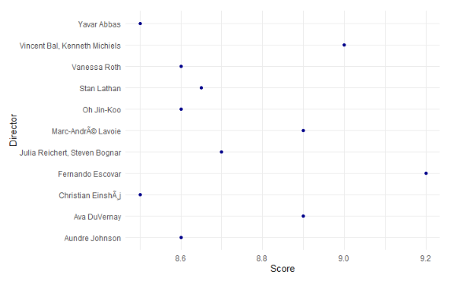
DIRECTOR RATINGS OVER SERIES

Slide 11
METHODS
Principal Component Analysis (Linear Relationships)
t Distributed Stochastic Neighborhood Embedding
(Non Linear Relationships)
DIMENS
IONS
Data: Population
Input Variables: Score, Hidden Gem Score,
Data: Sample (Size - 5000 Records)
Input Variables: Title, Genre, Languages, Actors, Score
Perplexity: 10, 30, 50
Hierarchical Clustering
k-Means Clustering
MODELL
ING
Data: Population
Input Variables: Title, Genre, Languages, Actors, Score, Hidden Gem Score
Data: Population
Input Variables: Title, Genre, Languages, Actors, Score, Hidden Gem Score

Slide 12
AGENDA
SUMMARY
METHODS
RESULTS
NEXT
STEPS

Slide 13
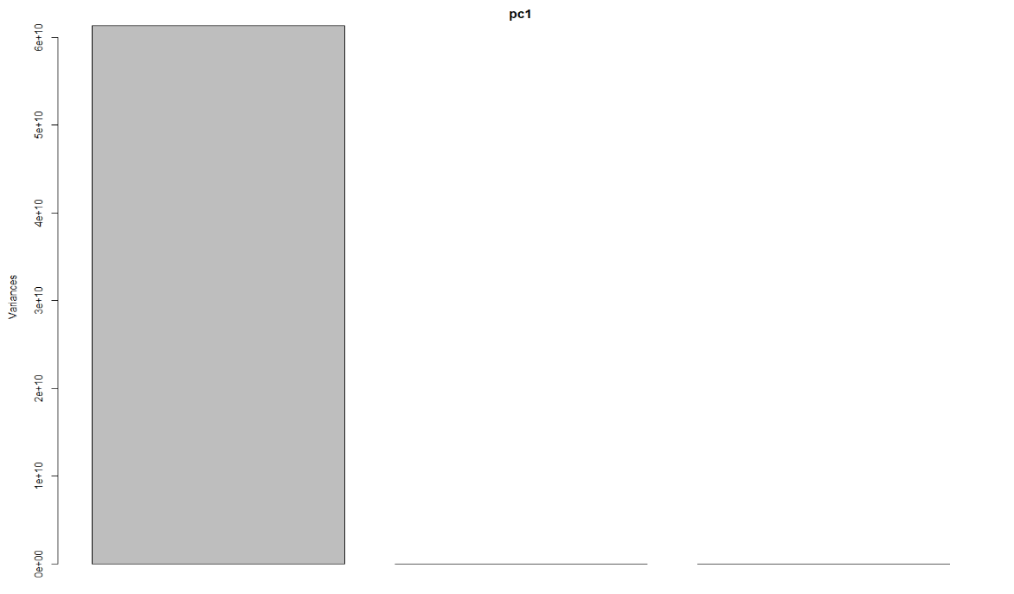
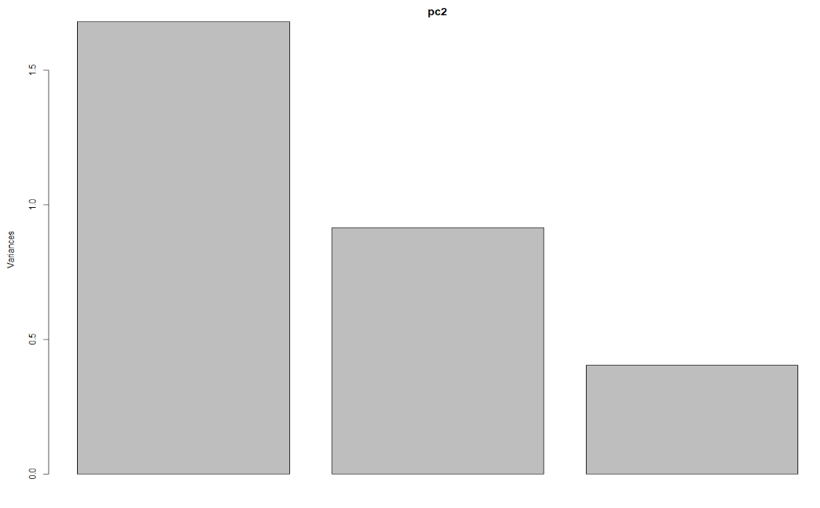


DIMENSION REDUCTION RESULTS - PCA
Unscaled PCA
Scaled PCA

Slide 14
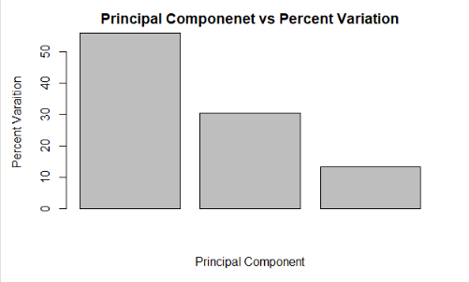
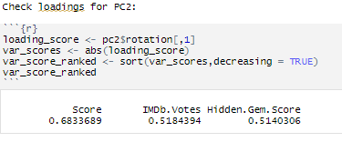
DIMENSION REDUCTION RESULTS - PCA
OBSERVATIONS
We used the scaled pca and prcomp() function to perform pca.
From the cumulative proportion we see that the first two components represents more than 85% of data.
And also from the Scree plot we determined that we only need the first two i.e, Score and Hidden.gem.score for our analysis.
From pca we determined how much variation each principal component accounts for and use loading scores to determine the effect of variables on the pca graph

Slide 15
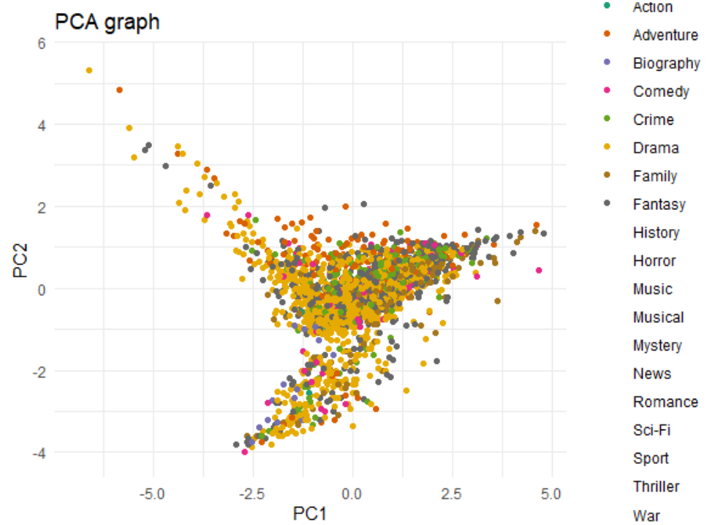
PCA VISUALIZATION

Slide 16
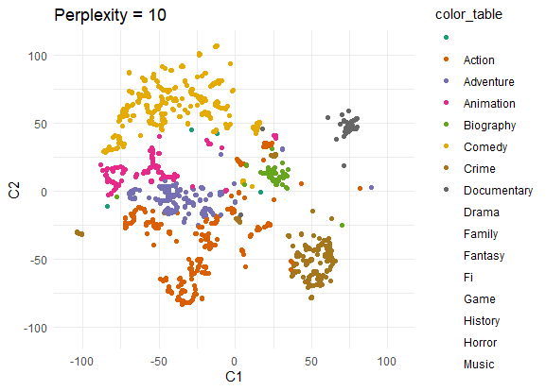
DIMENSION REDUCTION RESULTS - t SNE
Sample Size : 5000
OBSERVATIONS
Overlap is very high in the clusters given
Need a higher perplexity for better defined clusters

Slide 17
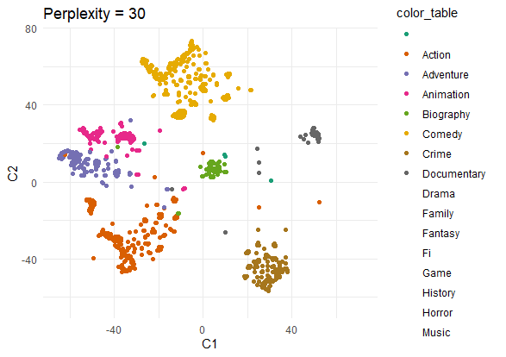
DIMENSION REDUCTION RESULTS - t SNE
Sample Size : 5000
OBSERVATIONS
Increase in Perplexity has led to more defined clusters as shown in graph
We still see some overlap in clusters

Slide 18
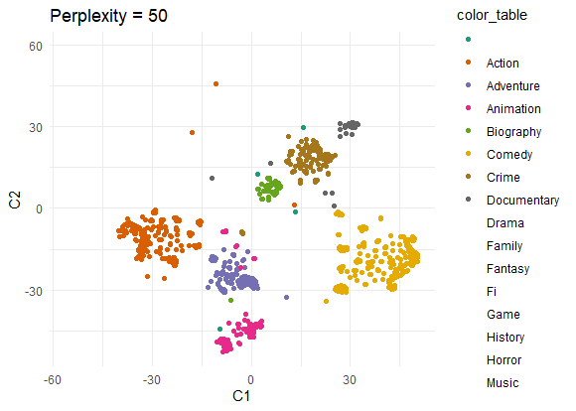
DIMENSION REDUCTION RESULTS - t SNE
Sample Size - 5000
OBSERVATIONS
Clearly defined clusters noted as we increased the perplexity from 30 to 50
Minimal overlap in clusters noted herein

Slide 19
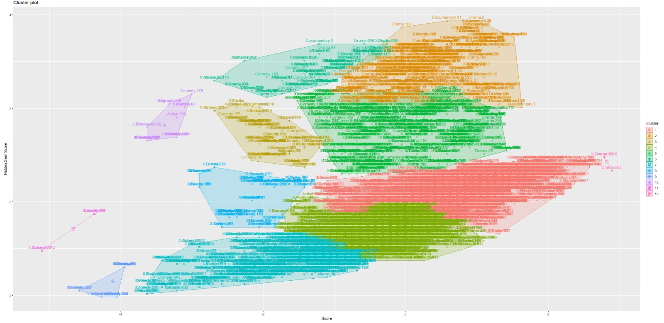
CLUSTERING RESULTS - HIERARCHICAL
OBSERVATIONS
Complete Linkage uses maximum distance between data points of 2 different clusters.
Data points of different clusters are found to be overlapping.

Slide 20
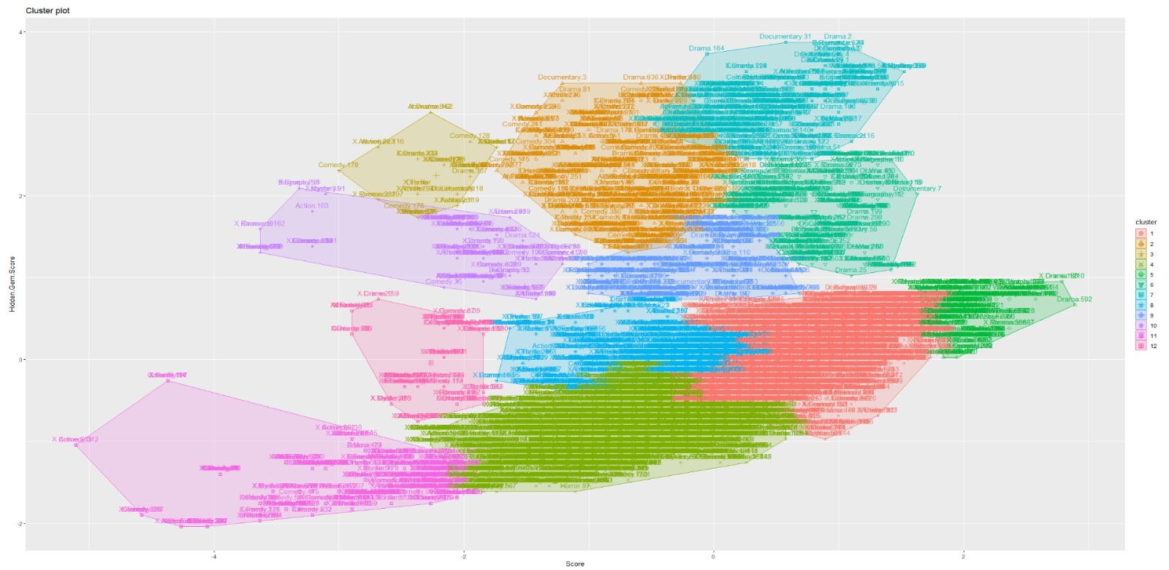
CLUSTERING RESULTS - HIERARCHICAL
OBSERVATIONS
Average Linkage uses average distance between data points from 2 different clusters.
Data points of different clusters are found to be overlapping.

Slide 21
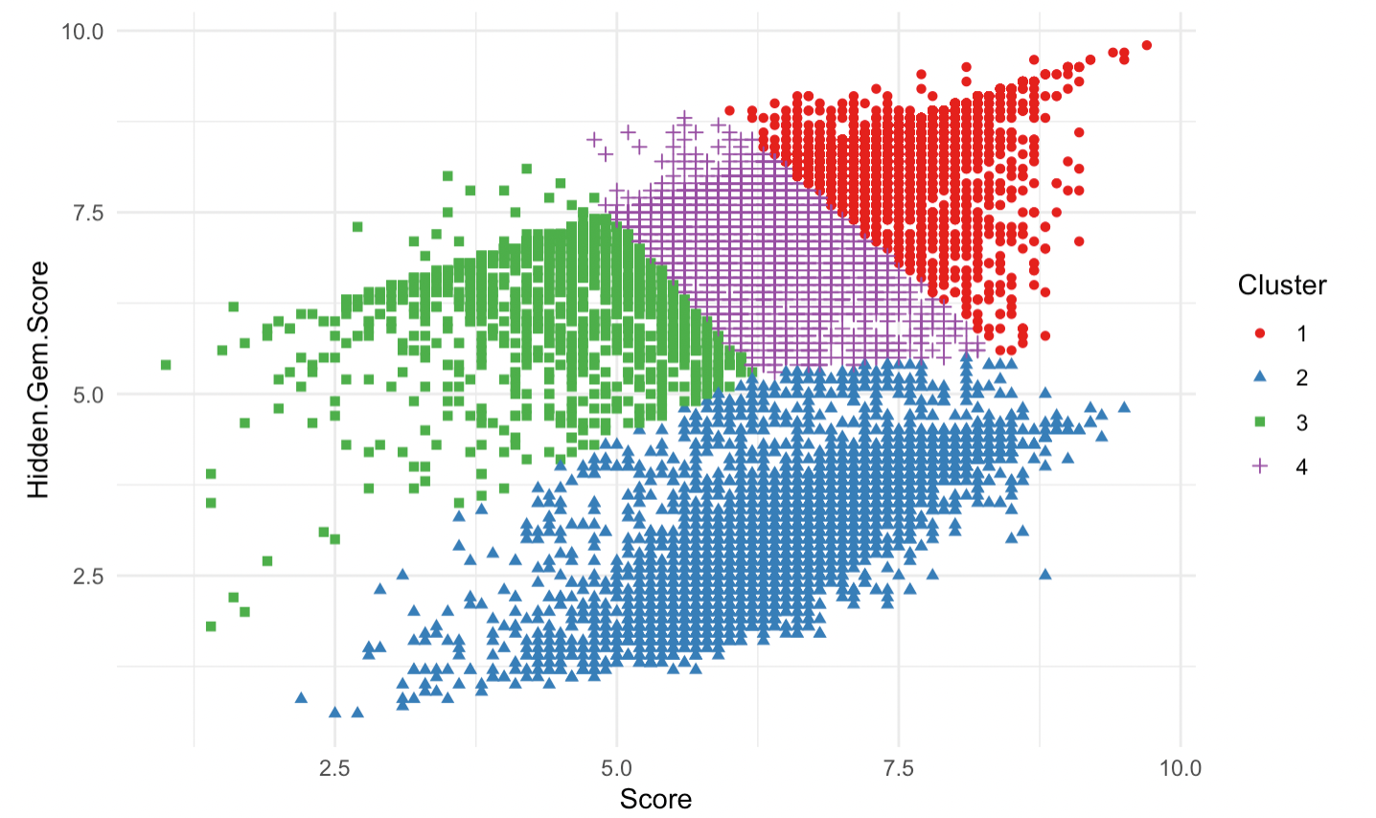
CLUSTERING RESULTS - k-Means
OBSERVATIONS
K Means has identified centroids with data points clustered all around the centroid.
K-Means doesn’t allow nearby data points to share the same cluster no matter how obvious the between them might be.

Slide 22
AGENDA
SUMMARY
METHODS
RESULTS
NEXT
STEPS

Slide 23
NEXT STEPS
Data Tidying
Visualize Key
Variables
Dimension
Reduction
Clustering
Techniques
Use clusters
to recommend
Movies/Shows based
on User Input
Current Progress
Plan Ahead

Slide 24
THANK YOU

Slide 25
APPENDIX A.
VISUALIZATION

Slide 26
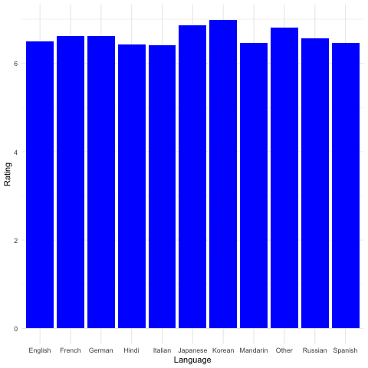
LANGUAGE LEVEL ANALYSIS OF RATINGS

Slide 27
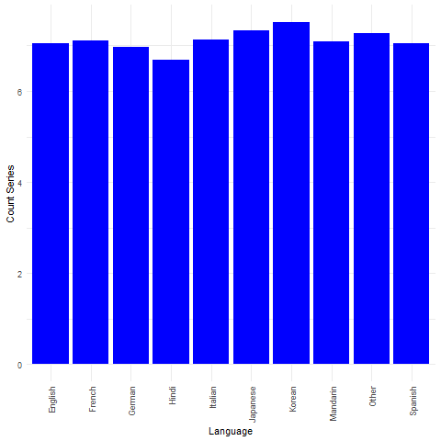
RATINGS VS LANGUAGES OVER SERIES

Slide 28
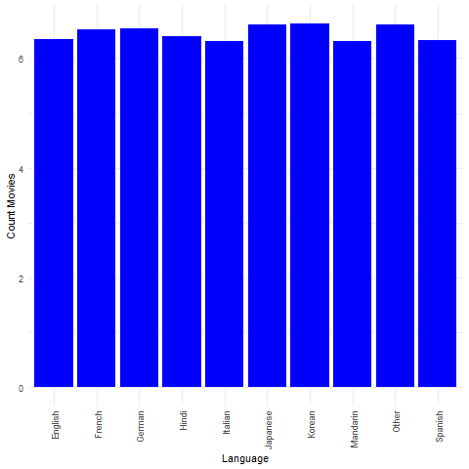
RATINGS VS LANGUAGES OVER MOVIES

Slide 29
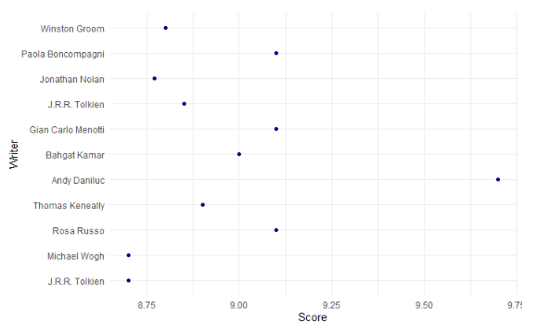
WRITER RATINGS OVER MOVIES

Slide 30
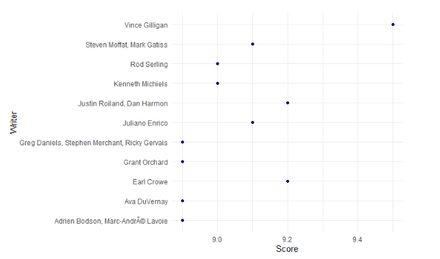
WRITER RATINGS OVER SERIES

Slide 31
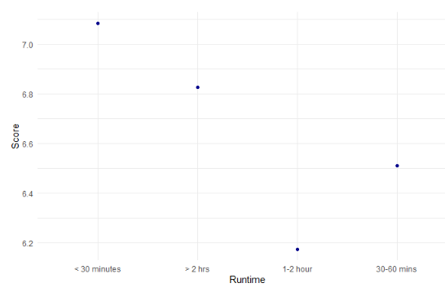
DURATION VS RATINGS

